Slide 1
Regular Expressions

Slide 2
What are they?
Text string used to define a search pattern
Uses metacharacters, regular characters and quantifiers
Meta characters – characters given special meaning
Regular characters – or literal characters, are taken for their literal meaning
Quantifiers – Specifies how often a preceding character can occur

Slide 3
Input
The input element allows for users input
Input types include: text, password, email, and submit.
Text allows for a one- line input field
Password signifies a password field and are masked
Email fields can be automatically validated
Submit is used to submit the user’s input to a form-handler
A form-handler is a script for processing input data
Input is typically found inside a form element

Slide 4
Input Attributes
Type is used to determine what type of input is desired
Name will label the input data from the user
Pattern is where your regular expression is placed
Title tells the user what is expected in the input field via mouse over and is also displayed after the browser’s error message
Value will auto fill the input field
Required is used to specify an input field must be filled out before submitting
Placeholder provides a hint as to the expected value for an input field

Slide 5
Meta Characters
Regex in HTML5 is slightly different than in other programming languages
Pattern attribute is matched against entire regex value
^(?: are not necessary at the start of a pattern and )$ are not necessary at the end
Global, ignoreCase and multiline are disabled
\d is used to search for digits
\s finds whitespace characters
A dot(.) matches any character
To use a meta character as a regular character place a \ before it

Slide 6
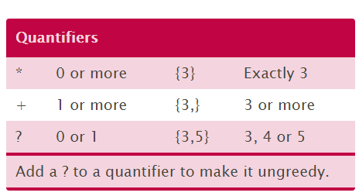
Quantifiers
Curly brackets are used to specify quantity
Pound symbol matches any number of characters and is the same as using {0,}
A plus sign matches if string contains at least one character and is the same as using {1,}
A question mark specifies 0 or 1 and is the same as using {0,1}
A comma can be used for more exact quantities
Quantifiers follow square brackets or parenthesis and the symbols can be used instead of curly brackets

Slide 7
Patterns
Square brackets are used to specify what to search for
Parenthesis are used for a sub patterns
A dash (-) is a range separator i.e. instead of [0123] you can use [0-3]

Slide 8
HTML Example

Slide 9
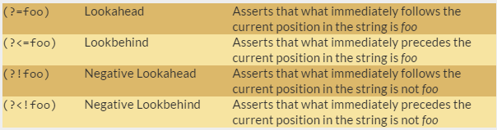
Lookarounds
Lookarounds are used to check for multiple regular expressions in one string
Returns with either a success or fail
If a lookaroud returns with a success, it uses the next lookaround on the same string and will only return the string if all lookarounds succeed

Slide 10
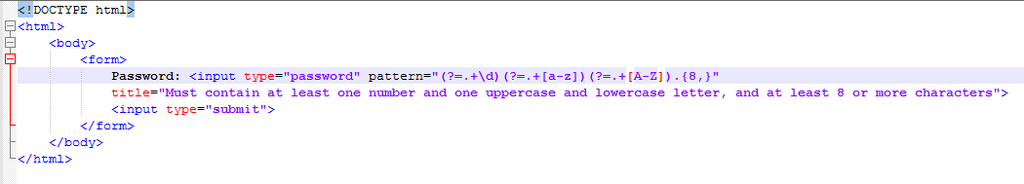
Lookaround Example

